Slide 1

Course project
School of Electronics and
Communication Engineering
Course Code:23EECE321
Course-OOPS Using C++
Title :Airline Reservation System using C++
Guide – Prof Sumita Guddin
TEAM – 06
Ganesh Deodurg-01fe22bec422 |Roll no-139
Sattvik Gurav- 01fe22bec004 |Roll no-113
Adarsh S Dadamode-01fe22bec082 |Roll no-252
CIM- ADAS

Slide 2
Contents
Introduction
Problem statement
Objective
Features of OOP Used in the Project
Flow Chart of Proposed System
Code Snippet for Result Analysis
Conclusion

Slide 3
INTRODUCTION
Title: Airline Reservation System using C++
Overview: This project is a console-based application that enables users to book flights, manage customer details, and generate tickets using Object-Oriented Programming (OOP) concepts in C++
Introduction-
The project titled "Airline Reservation System" is a console-based application developed using the C++ programming language.
It aims to simulate the core functionalities of an airline booking platform, enabling users to input customer details, register flights, and generate ticket information.
Designed using the Object-Oriented Programming (OOP) approach, this system demonstrates how C++ can be effectively utilized to manage complex real-world operations using modular and reusable code structures.
The application is user-friendly and operates through a simple text-based menu.

Slide 4
Problem Statement-
In the modern world, managing airline reservations manually is tedious, error-prone, and inefficient.
There is a need for a simplified digital system that helps in booking, canceling, and storing flight and passenger details with minimal user intervention.
The main challenge lies in building a system that can effectively handle user inputs, process bookings, and store data in an organized and retrievable format using a programming language like C++ that does not inherently support databases or graphical interfaces.

Slide 5
Objectives-
To develop a basic, user-interactive airline reservation system using C++.
To collect and manage customer details including name, age, and gender.
To allow flight selection based on destination and availability.
To generate a ticket containing flight and passenger details.
To demonstrate core OOP principles such as encapsulation, inheritance, and abstraction in a practical use-case.

Slide 6
Features of OOP Used in the Project-
The project makes extensive use of OOP concepts.
Encapsulation: Each class (like Details, Registration, and Ticket) bundles data members and methods, maintaining information hiding and modularity.
Inheritance: The Ticket class inherits from both Registration and Details, reusing the logic for user input and flight booking.
Abstraction: Only necessary details are exposed to the user through functions, hiding complex implementations.
Polymorphism is implicitly reflected through function calling and object interactions, though not via function overloading or overriding in this version.

Slide 7
Flow Chart of Proposed System
The flow of the program is as follows:
Start → Display Main Menu
If user selects1: → Input Customer Details → Back to Main Menu
If user selects 2: → Show Available Flights → Book Flight → Back to Main Menu
If user selects 3: → Generate Ticket → Option to Display Ticket → Back to Main Menu
If user selects 4: → Exit
Each operation ends by returning the user to the main menu unless they choose to exit.

Slide 8
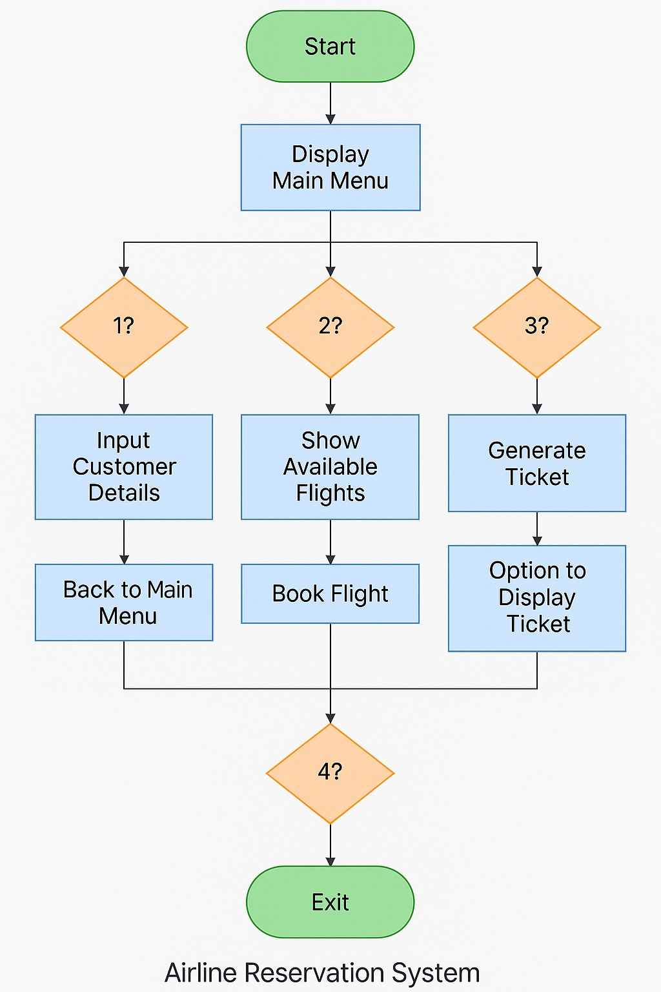

Slide 9
Code Snippet for Result Analysis
Here is an example of the code used to generate and store the ticket details in a text file
Cpp
Copy
Editofstream outf("records.txt");
outf<<"Customer ID: "<<Details::cId<<endl;
outf<<"Customer Name: "<<Details::name<<endl;
outf<<"Destination:\t\t"<<destination<<endl;
outf<<"Flight cost:\t\t"<<charges<<endl;
outf.close();
This snippet highlights how the system saves customer and booking information in a readable format, ensuring the persistence of data beyond runtime. The result is stored in records.txt, which can then be displayed using the dispBill() function.

Slide 10
#include<iostream>
#include<fstream>
#include<iomanip>
using namespace std;
void mainMenu();
class Management
{
public:
Management()
{
mainMenu();
}
};
class Details
{
public:
static string name, gender;
int phoneNO;
int age;
string add;
static int cId;
char arr[100];

Slide 11
void information()
{
cout<<"\n Enter the customer ID: ";
cin>>cId;
cout<<"\n Enter the name :";
cin>>name;
cout<<"\n Enter the age :";
cin>>age;
cout<<"\n Address :";
cin>>add;
cout<<"\n Gender :";
cin>>gender;
cout<<"Your details are saved with us\n"<<endl;
}
};
int Details::cId;
string Details::name;
string Details::gender;

Slide 12
class Registration
{
public:
static int choice;
int choice1;
int back;
static float charges;
void flights()
{
string flight[]={"Dubai","Canada","UK","USA","Australia","Europe"};
for(int a=0;a<6;a++)
{
cout<<(a+1)<<". flight to "<<flight[a]<<endl;
}
cout<<"\n Welcome to the Airlines!"<<endl;
cout<<"Press the number of the country of which you want to book the flight: ";
cin>>choice;

Slide 13
switch(choice)
{
case 1:
{
cout<<"_Welcome to Dubai Emirates\n"<<endl;
cout<<"Your comfort is our priority. Enjoy the journey!"<<endl;
cout<<"Following are the flights \n"<<endl;
cout<<"1. DUB - 498"<<endl;
cout<<"\t25-05-2025 8:00AM 10hrs Rs. 14000"<<endl;
cout<<"2. DUB - 658"<<endl;
cout<<"\t26-05-2025 4:00AM 12hrs Rs. 10000"<<endl;
cout<<"3. DUB - 508"<<endl;
cout<<"\t27-05-2025 11:00AM 11hrs Rs. 9000"<<endl;
cout<<"\n Select the flight you want to book :";
cin>>choice1;
if(choice1==1)
{
charges=14000;
cout<<"\n You have successfully booked the flight DUB - 498"<<endl;
}

Slide 14
else if(choice1==2)
{
charges=10000;
cout<<"\n You have successfully booked the flight DUB - 658"<<endl;
}
else if(choice1==3)
{
charges=9000;
cout<<"\n You have successfully booked the flight DUB - 508"<<endl;
}
else
{
cout<<"Invalid input , shifting to the previous menu"<<endl;
flights();
}
cout<<"Press any key to go back to the main menu:"<<endl;
cin>>back;
mainMenu();
break;
}

Slide 15
case 2:
{
cout<<"_Welcome to Canadian Airlines\n"<<endl;
cout<<"Your comfort is our priority. Enjoy the journey!"<<endl;
cout<<"Following are the flights \n"<<endl;
cout<<"1. CA - 198"<<endl;
cout<<"\t15-05-2025 2:00AM 20hrs Rs. 34000"<<endl;
cout<<"2. CA - 158"<<endl;
cout<<"\t16-05-2025 6:00AM 23hrs Rs. 29000"<<endl;
cout<<"3. CA - 208"<<endl;
cout<<"\t17-05-2025 12:00AM 21hrs Rs. 40000"<<endl;
cout<<"\n Select the flight you want to book :";
cin>>choice1;
if(choice1==1)
{
charges=34000;
cout<<"\n You have successfully booked the flight CA - 198"<<endl;
}

Slide 16
else if(choice1==2)
{
charges=10000;
cout<<"\n You have successfully booked the flight DUB - 658"<<endl;
}
else if(choice1==3)
{
charges=9000;
cout<<"\n You have successfully booked the flight DUB - 508"<<endl;
}
else
{
cout<<"Invalid input , shifting to the previous menu"<<endl;
flights();
}
cout<<"Press any key to go back to the main menu:"<<endl;
cin>>back;
mainMenu();
break;
}

Slide 17
case 3:
{
cout<<"_Welcome to UK Airways\n"<<endl;
cout<<"Your comfort is our priority. Enjoy the journey!"<<endl;
cout<<"Following is the flight \n"<<endl;
cout<<"1. UK - 798"<<endl;
cout<<"\t12-05-2025 10:00AM 14hrs Rs. 44000"<<endl;
cout<<"\n Select the flight you want to book :";
cin>>choice1;
if(choice1==1)
{
charges=44000;
cout<<"\n You have successfully booked the flight UK - 798"<<endl;
}
else
{
cout<<"Invalid input , shifting to the previous menu"<<endl;
flights();
}
cout<<"Press any key to go back to the main menu:"<<endl;
cin>>back;
mainMenu();
break;
}

Slide 18
case 4:
{
cout<<"_Welcome to US Airways\n"<<endl;
cout<<"Your comfort is our priority. Enjoy the journey!"<<endl;
cout<<"Following are the flights \n"<<endl;
cout<<"1. US - 567"<<endl;
cout<<"\t10-05-2025 9:00AM 22hrs Rs. 37000"<<endl;
cout<<"2. US - 258"<<endl;
cout<<"\t26-05-2025 6:00AM 22hrs Rs. 39000"<<endl;
cout<<"3. US - 808"<<endl;
cout<<"\t27-05-2025 10:00AM 21hrs Rs. 42000"<<endl;
cout<<"\n Select the flight you want to book :";
cin>>choice1;

Slide 19
if(choice1==1)
{
charges=37000;
cout<<"\n You have successfully booked the flight US - 567"<<endl;
}
else if(choice1==2)
{
charges=39000;
cout<<"\n You have successfully booked the flight US - 258"<<endl;
}
else if(choice1==3)
{
charges=42000;
cout<<"\n You have successfully booked the flight US - 808"<<endl;
}
else
{
cout<<"Invalid input , shifting to the previous menu"<<endl;
flights();
}
cout<<"Press any key to go back to the main menu:"<<endl;
cin>>back;
mainMenu();
break;
}

Slide 20
case 5:
{
cout<<"_Welcome to Australian Airlines\n"<<endl;
cout<<"Your comfort is our priority. Enjoy the journey!"<<endl;
cout<<"Following are the flights \n"<<endl;
cout<<"1. AS - 698"<<endl;
cout<<"\t18-05-2025 9:00AM 20hrs Rs. 44000"<<endl;
cout<<"2. AS - 158"<<endl;
cout<<"\t19-05-2025 4:00AM 22hrs Rs. 34000"<<endl;
cout<<"3. AS - 708"<<endl;
cout<<"\t17-05-2025 11:00AM 21hrs Rs. 42000"<<endl;
cout<<"\n Select the flight you want to book :";
cin>>choice1;
if(choice1==1)
{
charges=44000;
cout<<"\n You have successfully booked the flight AS - 698"<<endl;
}
else if(choice1==2)
{
charges=34000;
cout<<"\n You have successfully booked the flight AS - 158"<<endl;
}

Slide 21
else if(choice1==3)
{
charges=42000;
cout<<"\n You have successfully booked the flight AS - 708"<<endl;
}
else
{
cout<<"Invalid input , shifting to the previous menu"<<endl;
flights();
}
cout<<"Press any key to go back to the main menu:"<<endl;
cin>>back;
mainMenu();
break;
}

Slide 22
case 6:
{
cout<<"_Welcome to European Airlines\n"<<endl;
cout<<"Your comfort is our priority. Enjoy the journey!"<<endl;
cout<<"Following are the flights \n"<<endl;
cout<<"1. EU - 898"<<endl;
cout<<"\t02-05-2025 2:00AM 18hrs Rs. 36000"<<endl;
cout<<"2. EU - 958"<<endl;
cout<<"\t03-05-2025 6:00AM 19hrs Rs. 37000"<<endl;
cout<<"3. EU - 608"<<endl;
cout<<"\t12-05-2025 10:00AM 20hrs Rs. 31000"<<endl;
cout<<"\n Select the flight you want to book :";
cin>>choice1;
if(choice1==1)
{
charges=36000;
cout<<"\n You have successfully booked the flight EU - 898"<<endl;
}
else if(choice1==2)
{
charges=37000;
cout<<"\n You have successfully booked the flight EU - 958"<<endl;
}

Slide 23
else if(choice1==3)
{
charges=31000;
cout<<"\n You have successfully booked the flight EU - 608"<<endl;
}
else
{
cout<<"Invalid input , shifting to the previous menu"<<endl;
flights();
}
cout<<"Press any key to go back to the main menu:"<<endl;
cin>>back;
mainMenu();
break;
}
default:
{
cout<<"Invalid input, shifting you to the main menu !"<<endl;
mainMenu();
break;
}
}
}
};

Slide 24
float Registration::charges;
int Registration::choice;
class Ticket : public Registration, public Details
{
public:
void Bill()
{
string destination = "";
ofstream outf("records.txt");
{
outf<<"_XYZ airlines"<<endl;
outf<<"_Ticket"<<endl;
outf<<"_"<<endl;
outf<<"Customer ID: "<<Details::cId<<endl;
outf<<"Customer Name: "<<Details::name<<endl;
outf<<"Customer Gender: "<<Details::gender<<endl;
outf<<"\tDescription"<<endl<<endl;
if(choice == 1) destination = "Dubai";
else if(choice == 2) destination = "Canada";
else if(choice == 3) destination = "UK";
else if(choice == 4) destination = "USA";
else if(choice == 5) destination = "Australia";
else if(choice == 6) destination = "Europe";
outf<<"Destination:\t\t"<<destination<<endl;
outf<<"Flight cost:\t\t"<<charges<<endl;
} outf.close(); }

Slide 25
void dispBill()
{
ifstream ifs("records.txt");
{
if(!ifs)
{
cout<<"File error!"<<endl;
return;
}
while(ifs.getline(arr, 100))
{
cout<<arr<<endl;
}
}
ifs.close();
}
};

Slide 26
void mainMenu()
{
int lchoice;
int schoice;
int back;
cout<<"\t XYZ Airlines \n"<<endl;
cout<<"\t__Main Menu"<<endl;
cout<<"\t__"<<endl;
cout<<"\t|\t press 1 to add the customer Details \t|"<<endl;
cout<<"\t|\t press 2 for Flight Registration \t|"<<endl;
cout<<"\t|\t press 3 for Ticket and charges \t|"<<endl;
cout<<"\t|\t press 4 to Exit \t|"<<endl;
cout<<"\t__"<<endl;
cout<<"Enter the choice :";
cin>>lchoice;
Details d;
Registration r;
Ticket t;

Slide 27
switch(lchoice)
{
case 1:
{
cout<<"Customers\n"<<endl;
d.information();
cout<<"Press any key to go back to Main Menu: ";
cin>>back;
mainMenu();
break;
}
case 2:
{
cout<<"_Book a flight using this system\n"<<endl;
r.flights();
break;
}

Slide 28
case 3:
{
cout<<"_GET YOUR TICKET\n"<<endl;
t.Bill();
cout<<"Your ticket is printed, you can collect it \n"<<endl;
cout<<"Press 1 to display your ticket: ";
cin>>back;
if(back==1)
{
t.dispBill();
cout<<"Press any key to go back to main menu:";
cin>>back;
mainMenu();
}
else
{
mainMenu();
}
break;
}
case 4:
{
cout<<"\n\n\t__Thank-you_"<<endl;
break;
}

Slide 29
default:
{
cout<<"Invalid input, please try again!\n"<<endl;
mainMenu();
break;
}
}
}
int main()
{
Management Mobj;
return 0;
}

Slide 30
Conclusion
The Airline Reservation System demonstrates how C++ and Object-Oriented Programming can be effectively used to simulate real-world booking applications. By modularizing the tasks into separate classes and functions, the project promotes reusability and scalability. Although basic, this system lays the foundation for more advanced implementations, including GUI integration and database connectivity. It proves that even with a command-line interface, a well-structured program can deliver robust user experiences and practical solutions.

Slide 31
Thank you

